Slide 1
Signet Home Inspections
is an experienced, independently owned, multi-inspector company offering property inspections in Placer and Nevada Counties.

Slide 2
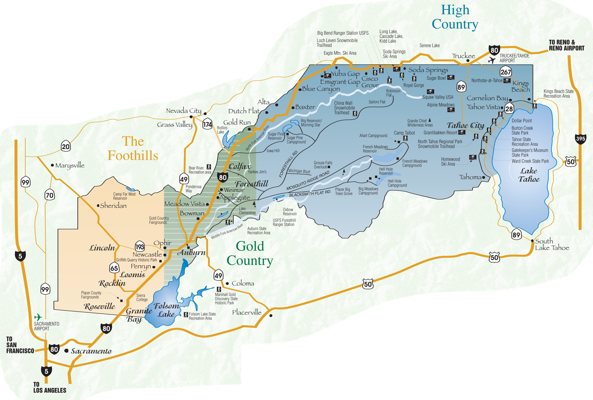
Placer and Nevada Counties

Slide 3
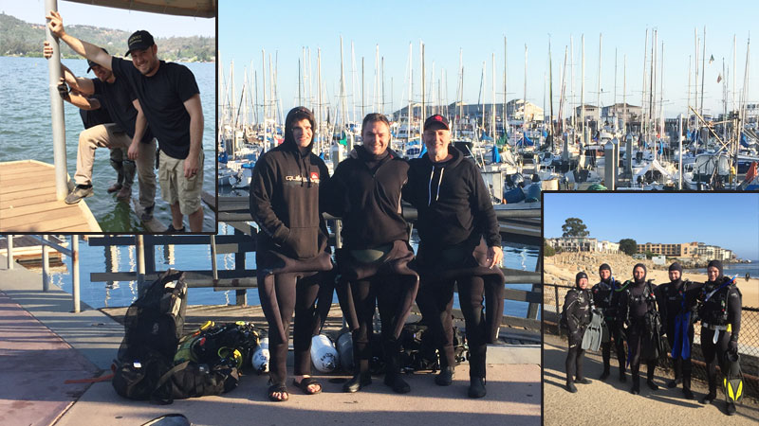
The Team
As a company, we are more than just a collection of individually qualified home inspectors. We are a “Band of Brothers” that work together, play together, and collaborate together to be the best we can be.

Slide 4
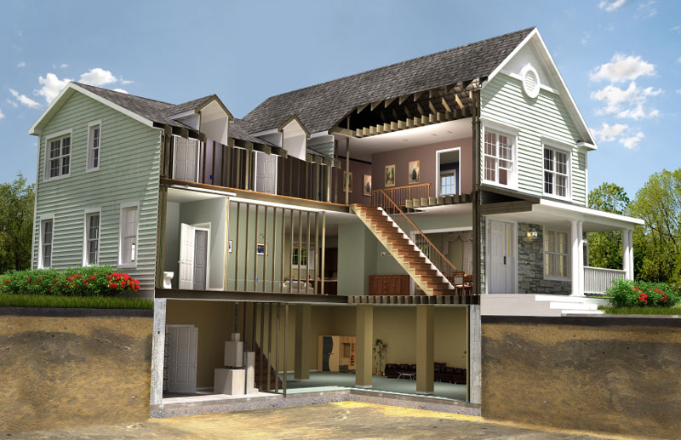
The Inspection

Slide 5
At Signet Home Inspections our goal is simple:
To provide home buyers and sellers alike with the best home inspection possible.
One that is as our tagline states “Sealed with Pride – Stamped with Confidence”.
By affiliating with InterNACHI, the most prestigious home inspection association in the world…
We have committed ourselves to the highest industry standards in both integrity and technical excellence.

Slide 6
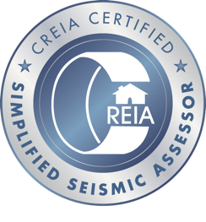
Every home inspection organization has their own “Standards of Practice” for performing inspections.
All are very similar and not intended to be exhaustive.
All have relatively high standards that cover minimum requirements an inspector must follow.
Most inspectors are comfortable using these as their baseline...
We are not.

Slide 7
At Signet Home Inspections, we do things a little differently.
You see, we don’t just meet the minimum industry standards…
We are in fact committed to exceeding them in every way possible.
We not only want to make sure your client's home is well-inspected…
We also want to make sure they are well-cared for in the process.

Slide 8
We can also provide a detailed commercial property condition assessment for:
Individual Companies
Investors
Developers
To assist in the decision making process when buying, leasing or selling a commercial building.

Slide 9
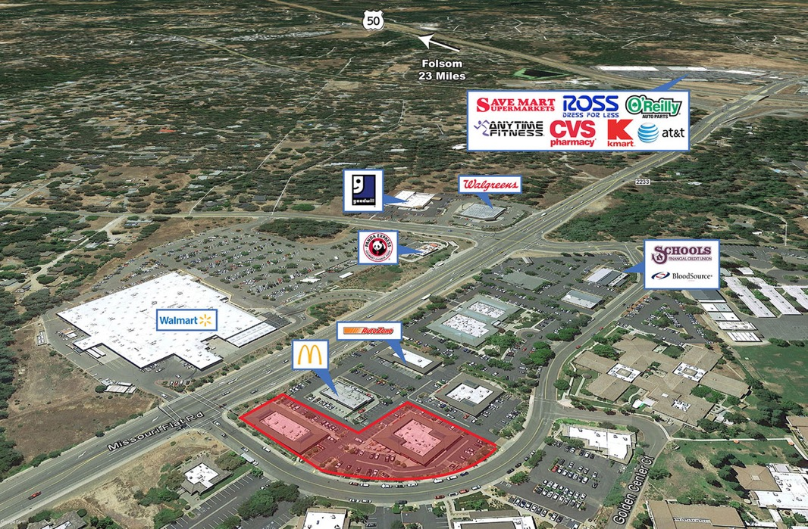
Our commercial building inspections typically include evaluating:
ADA access and public safety compliance.
Robust HVAC, electrical and plumbing systems.
Building techniques like industrial cold-formed steel framing and historic circa 1800 structures that require specific knowledge.

Slide 10
We have provided a Northern California commercial building inspection for a wide variety of properties including:
showroom/warehouse buildings
restaurant buildings
multi-floor office buildings
historic masonry buildings
retail store buildings
boutique hotel buildings
and mixed-use buildings that include both commercial and living space

Slide 11
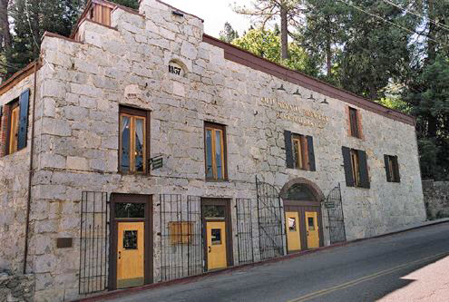
The Stone House
9,803 Sq. Ft.
Historic Restaurant
Nevada City, California

Slide 12
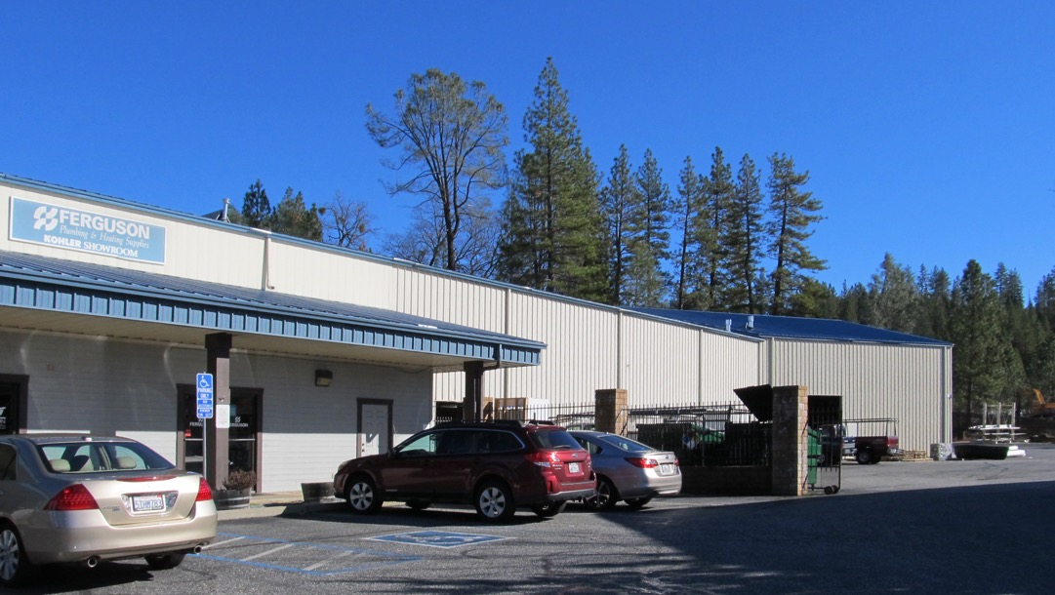
Ferguson Plumbing
25,000 Sq. Ft.
Showroom/Warehouse
Grass Valley, California

Slide 13
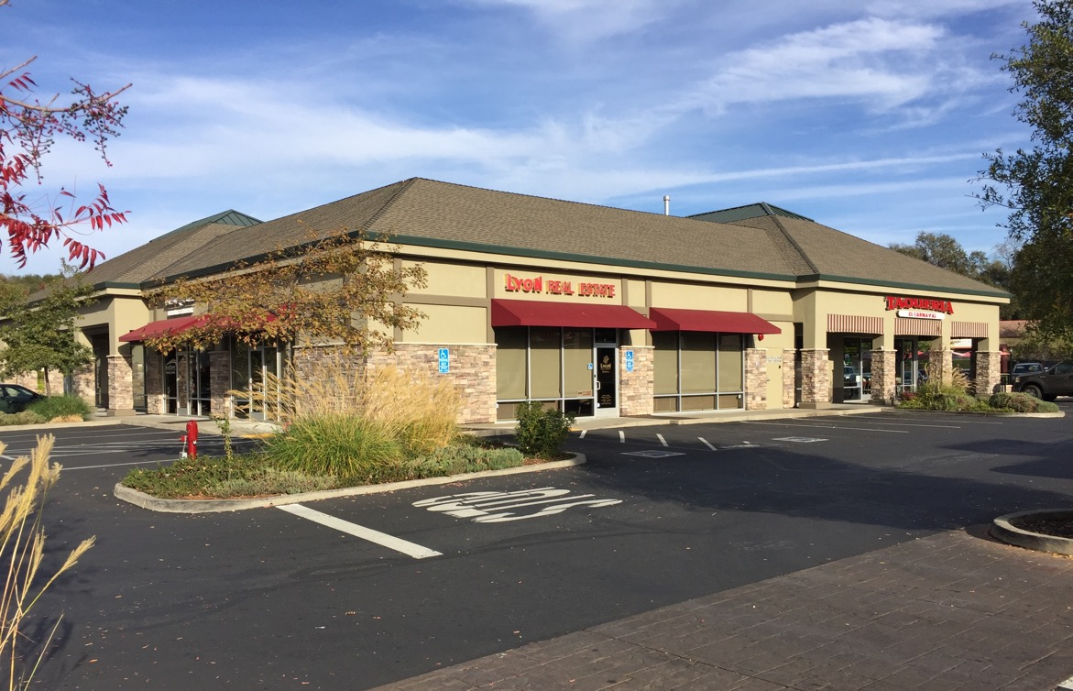
Golden Center
Plaza
18,046 Sq. Ft.
Shopping Center
El Dorado Hills, California

Slide 14
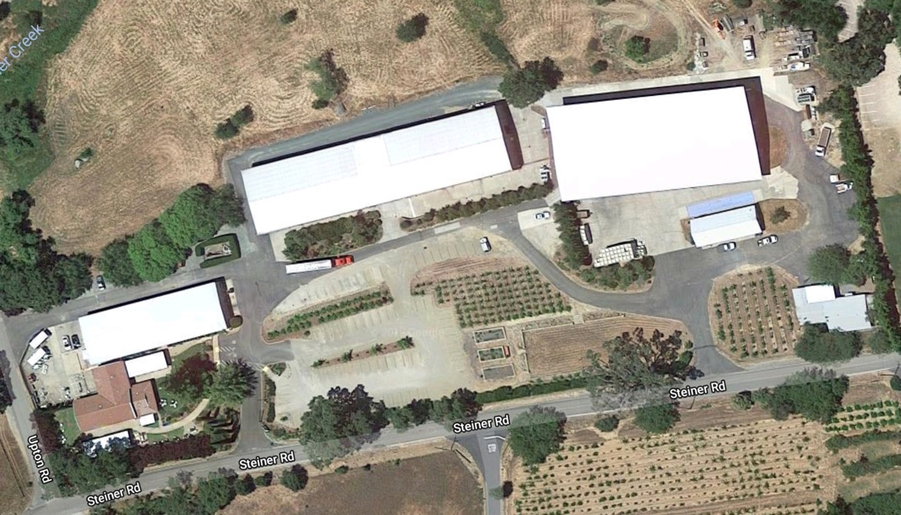
Renwood Winery
54,769 Sq. Ft.
Winery Complex
Plymouth, California

Slide 15
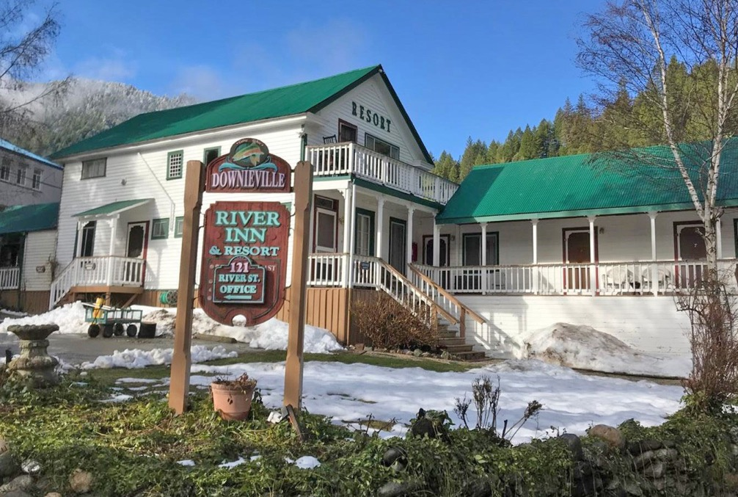
River Inn & Resort
5,250 Sq. Ft.
13 Room Boutique Hotel
Downieville, California

Slide 16
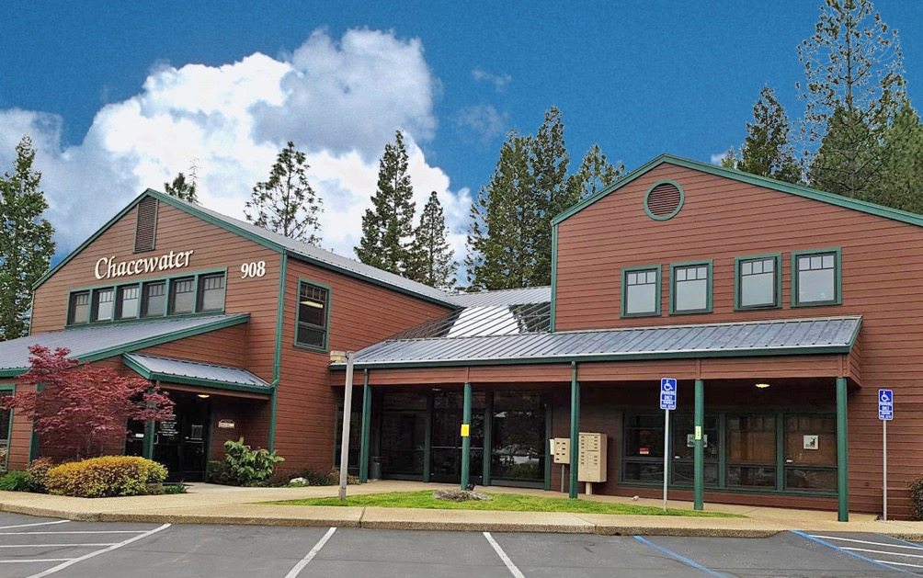
Chacewater
Office Complex
11,676 Sq. Ft.
Multi-Floor Office Building
Grass Valley, California

Slide 17
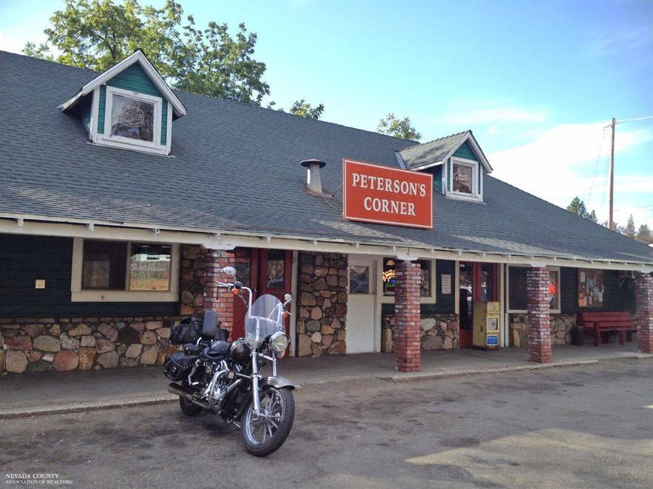
Peterson’s Corner
4,100 Sq. Ft.
Roadhouse
North San Juan, California

Slide 18
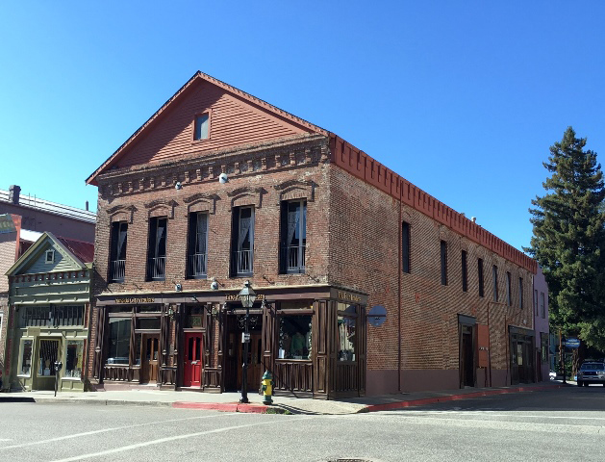
Fur Traders
8,436 Sq. Ft.
Retail/Bed & Breakfast
Nevada City, California

Slide 19
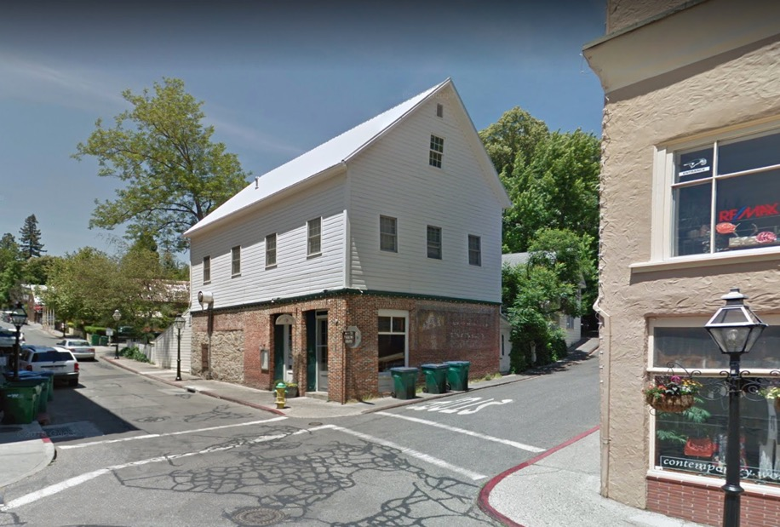
Mateo’s Public
2,598 Sq. Ft.
Restaurant/Apartment
Nevada City, California

Slide 20
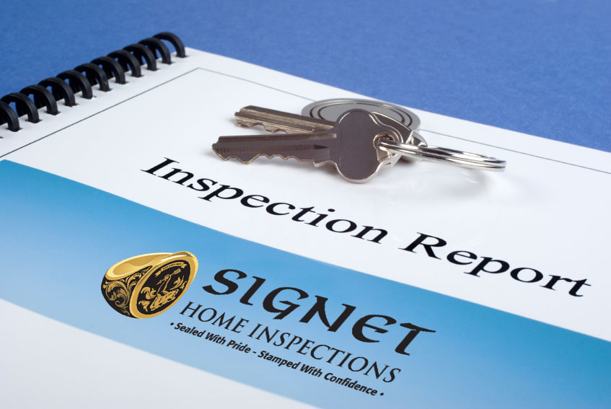
The Report

Slide 21
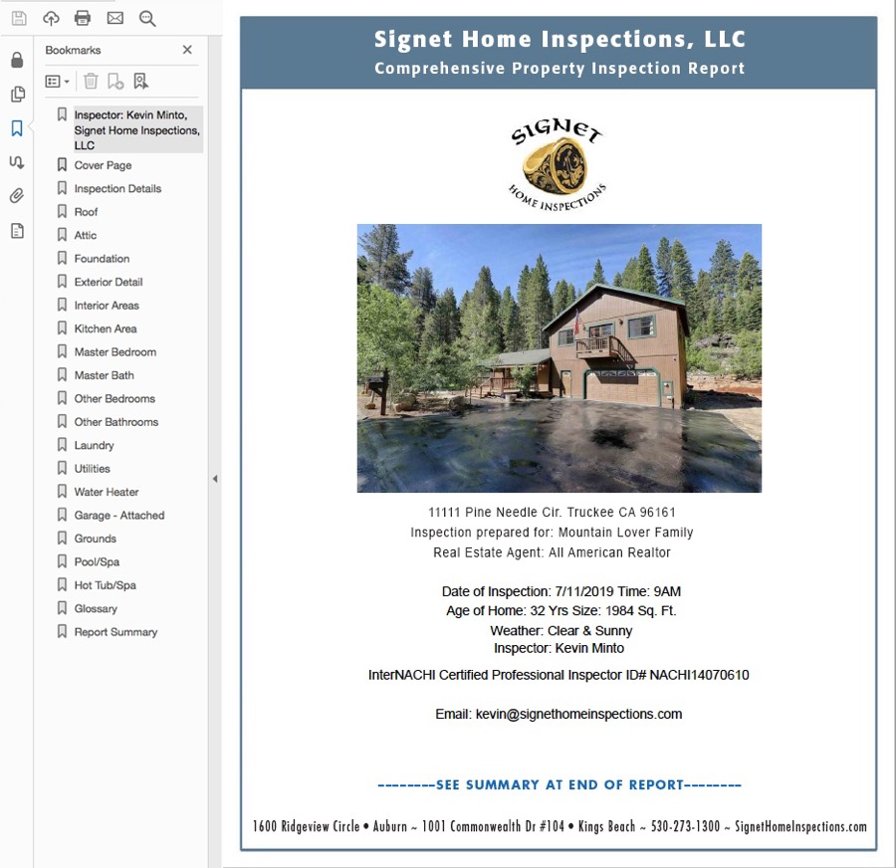
Everything the client pays for is reflected in the inspection report.
The experience, the insight, the effort, the readability.
So it only makes sense to use it as a benchmark when choosing your home inspector.
We challenge you to compare our report to our competition...
And we think you'll see the difference.

Slide 22
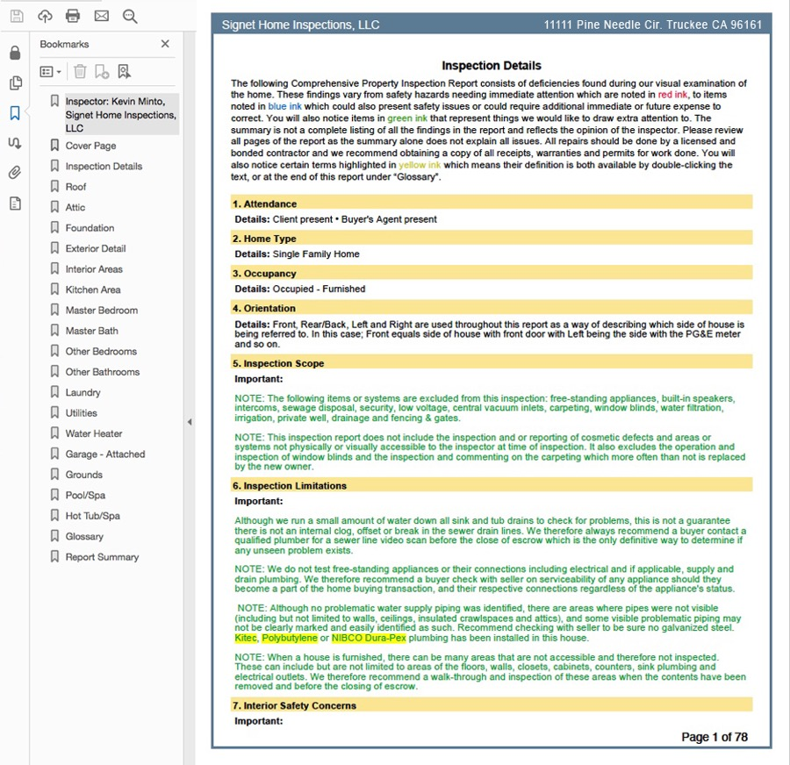
Our reports are ordered logically as if you were walking around or through the house.
We include a sidebar to jump from one area to another.
Comments are color-coded for easy recognition.
Technical terms are highlighted for quick access to the definition.

Slide 23
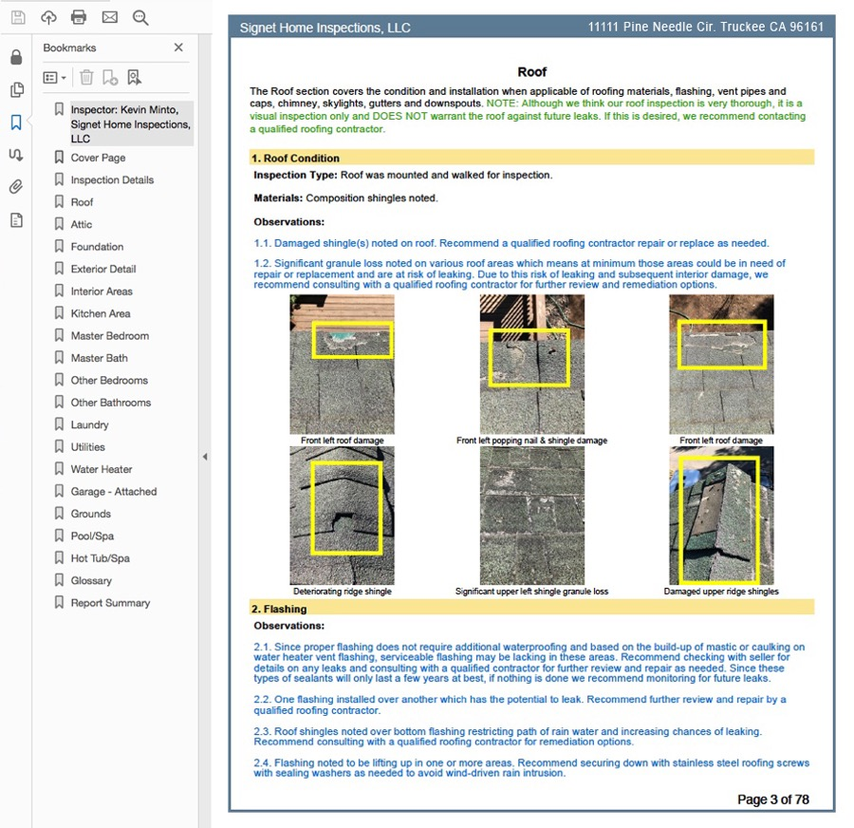
We provide a detailed, thoughtful and customized report.
Included are photos of deficiencies, items of interest and areas not easy to see like the attic or roof.
We go the extra mile to provide captions for our images so they are easy to understand.
We provide custom comments and commentary when appropriate, not canned statements.

Slide 24
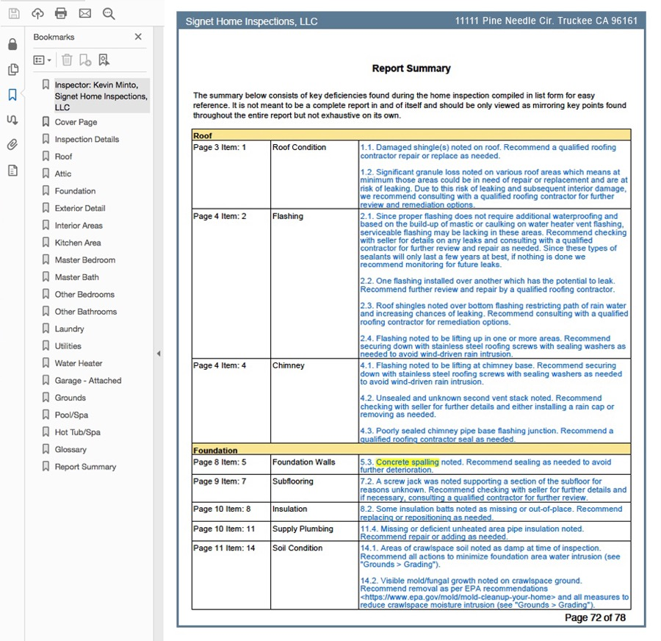
REALTORS© representing our clients are extremely busy juggling many things at once.
They prefer a quick summary especially of the safety issues that have been identified.
So our report ends with a summary of defects, color-coded for easy identification according to importance.

Slide 25
The Technology

Slide 26
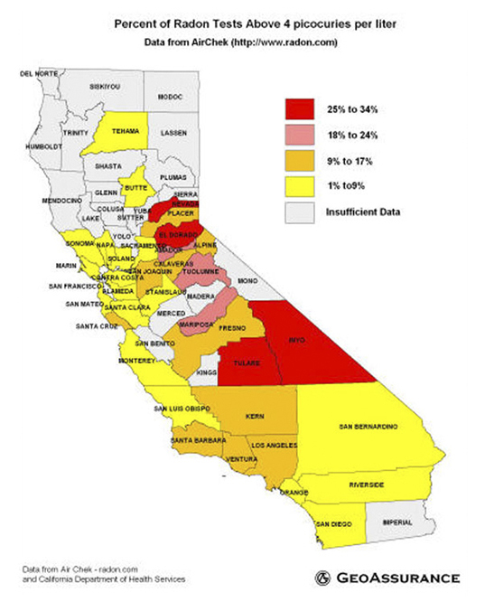
Radon Testing
The EPA recommends every home be tested for radon
1 in every 15 homes in the US has an elevated radon level (4pCi/L or more) that can cause cancer
In Truckee that ratio is 1 in 4
In North Lake Tahoe that ratio is 1 in 5
In South Lake Tahoe that ratio is 1 in 2
We are one of a select group in Northern California certified by the National Radon Professional Program (NRRP) and legally able to conduct radon testing

Slide 27
Mold Inspection & Testing
Roughly 10% of Americans are allergic to mold, in only 5% the allergy may result in an actual illness
We are IAC2 certified by the International Association of Indoor Air Consultants
We use state-of-the-art sampling equipment that is calibrated before every test
We ship every sample to a well-respected ISO/IEC 17025 accredited laboratory for analysis
We discourage sampling unless absolutely necessary

Slide 28
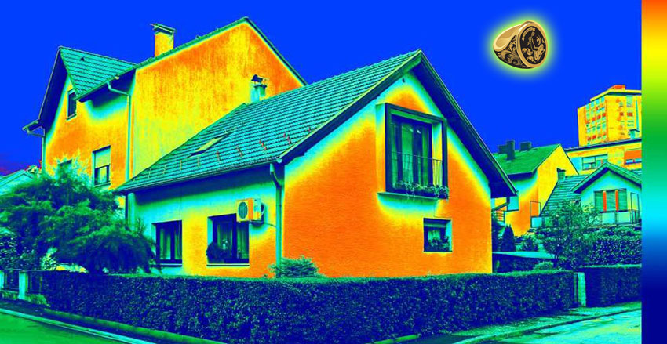
Infrared Inspections: We use Infrared Thermography (IRT) for fast, reliable and accurate analysis of various home systems enabling us to see what cannot be seen with the naked eye. “Don't be kept in the dark, be sure your home inspector is using thermal imaging.”

Slide 29
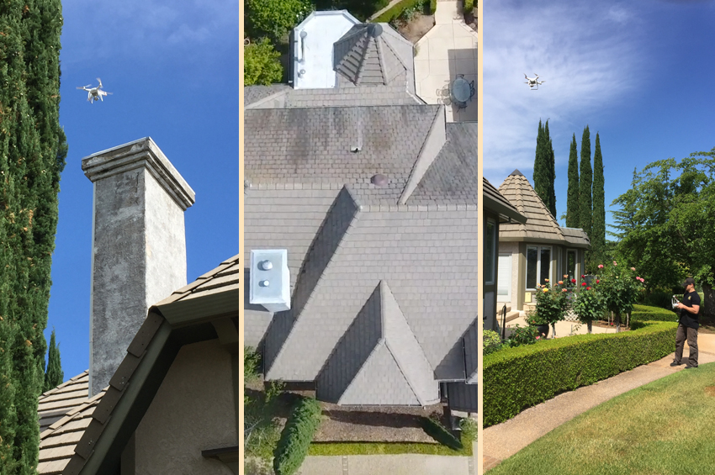
Drone Inspections
Drone inspections allow us to inspect areas of a residential or commercial structure that would otherwise be inaccessible
Not just a roof that cannot be mounted, but also the exterior cladding on a multi-story building that is visibly out-of-reach
Our drone inspections have proven to be an invaluable tool identifying defects otherwise left unknown
The FAA requires an Unmanned Aircraft Systems (UAS) pilot to be certified
We are not only FAA certified, but we are insured as well

Slide 30
Thank you for considering Signet Home Inspections for your next property inspection.
Kevin Minto, President
P: 530.273.1300 | www.signethomeinspections.com

